Slide 1

FORM AGENT
Presented By-
Ashish Tiwari
Charlie Neopane
Matthew Chuong
Miraji Mlilingwa

Slide 2


IT DOESN’T MEAN FORMING AN AGENT

Slide 3
SO WHAT IS FORM AGENT???
IT’S AN ANDROID APPLICATION.
IT MANAGES EXCEL FORM IN AN ORGANISATION.
FORM AGENT WILL PROMPT USER/ ADMIN IF THERE ARE ANY BLANK SPACE IN AN EXCEL FORM.

Slide 4

SO WHOSE IDEA IT WAS TO MAKE THIS APPLICATION
THIS GUY, MATTHEW CHUONG.

Slide 5


WHY FORM AGENT???

Slide 6

MISSING DATA
EVERY YEAR, SO MANY ORGANISATIONS HAVE TO SPEND TOO MUCH ON DEALING WITH MISSING DATA IN EXCEL PLANS.
THAT RESULTS IN DECREMENT IN PROFITS

Slide 7
REGISTRATION

Slide 8
Form Agent
Register
Admin
Successful
Full Name:____
Email:___
Username:____
Password:____
ReEnterPassword:____
Company Name:____
Check your email for
Confirmation code
User: _____
Agent Code: ___
Password:____
Admin
User
The code is admin generated
So they make their own code
Confirmation code:___
Signup/Register
Next
Submit
Submit
When button is clicked
When admin is checked

Slide 9
Register
User
Successful
Form Agent
Full Name:____
What is your agent code?
Email:___
Username:____
Password:____
ReEnterPassword:____
Agent code:____
Check your email for
Confirmation code
User: _____
Admin
User
Confirmation code:___
Password:____
Next
Submit
Submit
Signup/Register
When User is checked

Slide 10
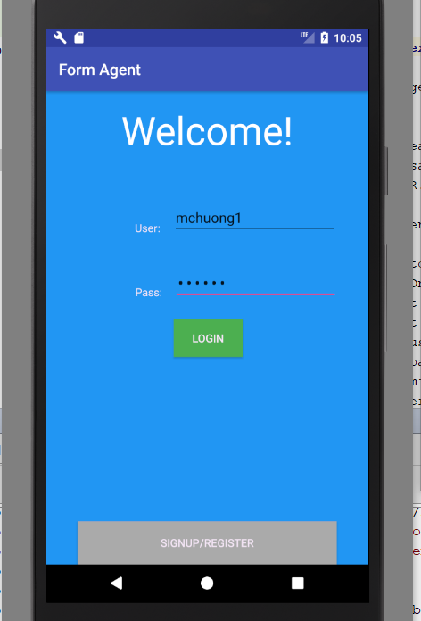
LOGIN CREDENTIALS
Username validations
-at least 6 characters
-all lowercase
Password validations
-at least 1 uppercase, digit, and special character consisting of "@#$%"
-minimum 6 characters

Slide 11
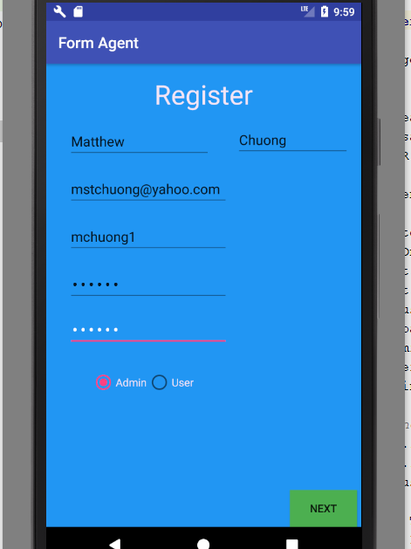
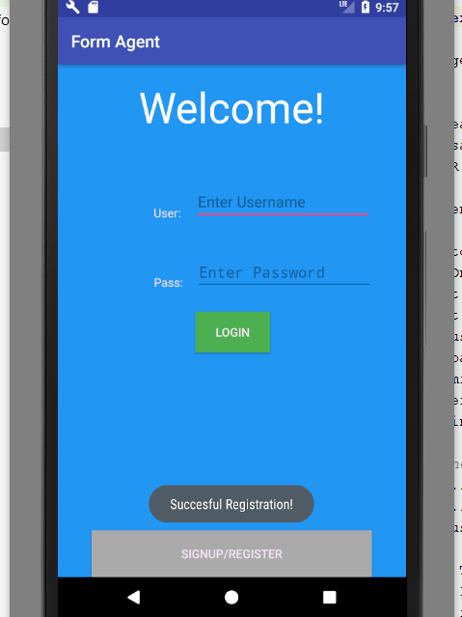

Slide 12
UPLOADING FORMS

Slide 13
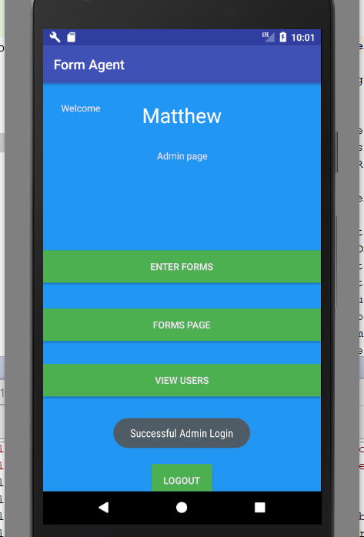
ADMIN LOGIN

Slide 14
Form Agent
Welcome [Your Name]
Admin Page
Submit Forms
View Users
Display users working
For your company
Submit Form
Admins will also
Be able to delete
Users that may have
retired/quit.
Enter Forms
preview
Username
Delete
Excel Document
User: _____
Forms Page
Password:____
View Users
Signup/Register
Logout
Finish
When admin logs in
Admins will be able to connect
Their device to the computer to drag and
drop the form they want to submit.

Slide 15
VIEWING FORMS

Slide 16
Welcome [Your Name]
Admin Page
Forms Page
Selected form
Excel Document
Enter Forms
Company
Form
Customer Name:____
Claim #:______
Cost of labor:_____
Cost of supplies: _____
Form was
sent successfully
Forms Page
Employee on Duty: Matthew
View Users
Logout
Select
Send email
User/Admin will highlight then
Press select to use the form
After a few seconds they will be sent
Back to the homepage

